Slide 1
Introduction to Energy Systems
Module 8
Part 1: Hydropower
Prepared by: Prof. Amin Ghobeity
Please do not distribute without permission

Slide 2

References
+ Instructor notes
Alternative Energy Systems and Applications Paperback
By Hodge
Fundamentals and Applications of Renewable Energy
Mehmet Kanoglu
Yunus A. Cengel
John M. Cimbala

Slide 3
Learning Objectives
The potential energy associated with water.
The kinetic energy associated with water.
The different types of water turbines and their applications.
The design and properties of various hydroelectric system.
Basic hydraulic analysis and determination of energy losses in a hydropower plant
Financial analysis of hydropower

Slide 4
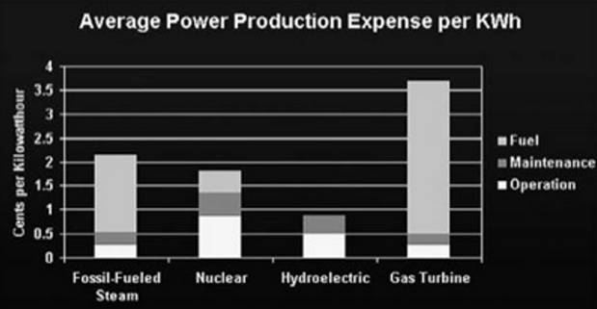
INTRODUCTION
Canada generates more than 50 percent of its electricity by hydropower; ~16% or world's electricity
Large hydroelectric dams require large capital investments and a time scale of years to build and complete. Once complete, hydroelectric power has the lowest operating costs of any electricity source.

Slide 5
Energy from water
The energy associated with water running downhill can be harnessed by turbines in two ways:
(1) potential energy associated with water confined behind a dam (high head systems)
(2) kinetic energy associated with flowing water (run-of-the-river systems)

Slide 6
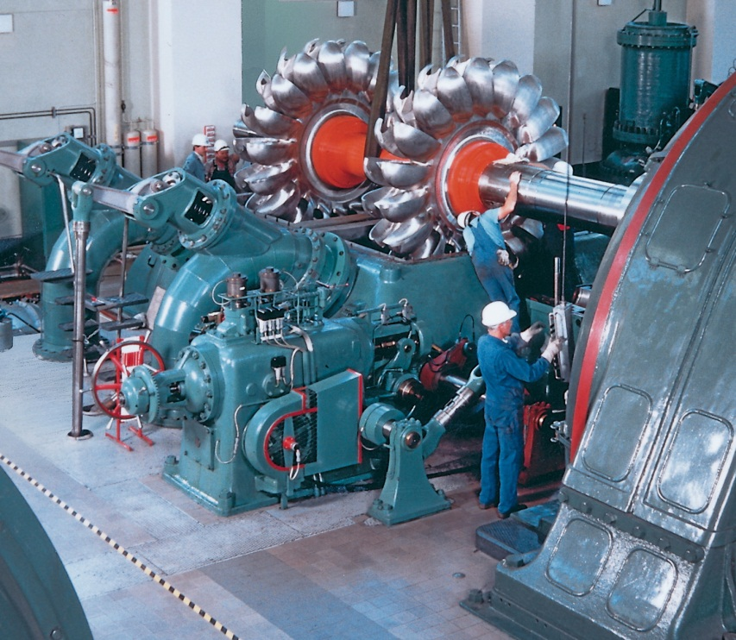
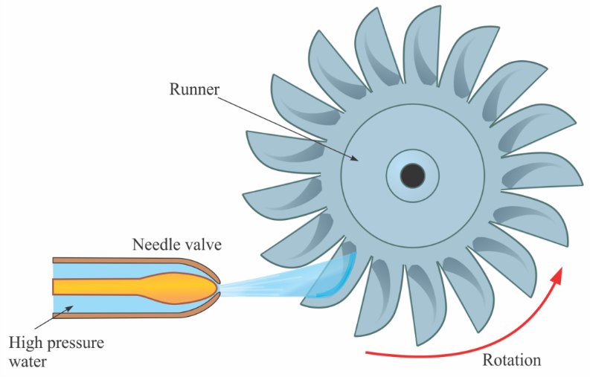
Water Turbines – Impulse Turbines
There are two classifications of water turbines:
An impulse turbine is a rotary engine that changes the direction of a high velocity fluid, thus converting kinetic energy into mechanical rotating energy.
There are two classifications of water turbines:
An impulse turbine is a rotary engine that changes the direction of a high velocity fluid, thus converting kinetic energy into mechanical rotating energy.
Impulse turbines are primarily used in applications with high pressure heads and relatively lower flow rates.

Slide 7
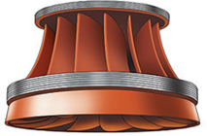
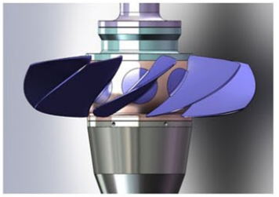
Water Turbines – Reaction Turbines
Reaction turbines are the second type; they develop torque from the pressure of water and are submerged at all times.
The Francis turbine is the most widely used reaction turbine and is used in moderate-head, high-volume applications. The Kaplan turbine is a propeller type reaction turbine used in low-head applications such as run-of-the river systems.
Orengine International Ltd.
Francis turbine Kaplan turbine

Slide 8
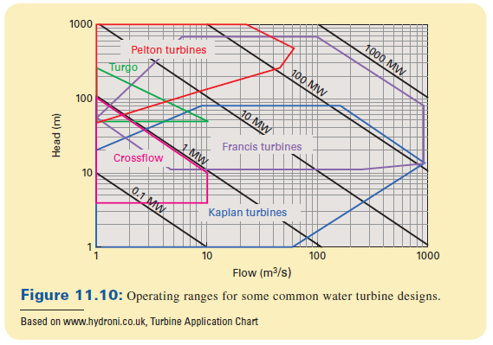
Operating Range of Turbines

Slide 9
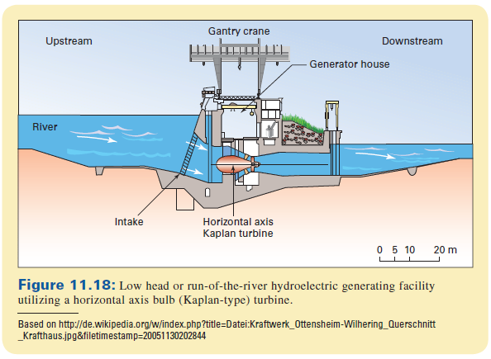
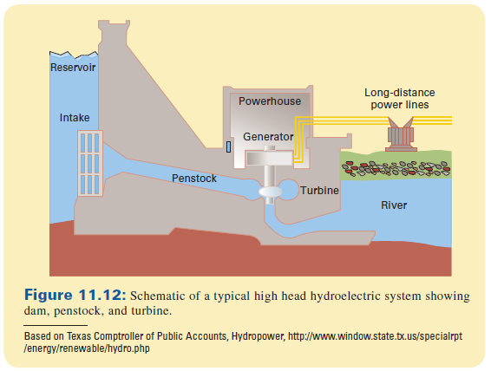
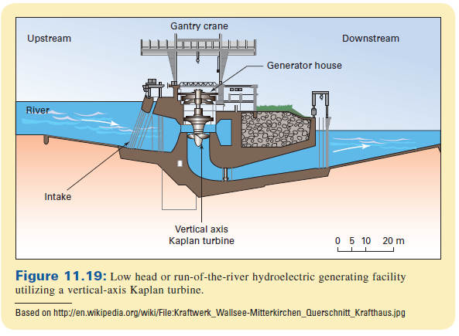
Example Arrangement
horizontal axis Kaplan turbine
vertical axis Francis turbine
vertical axis Kaplan turbine

Slide 10
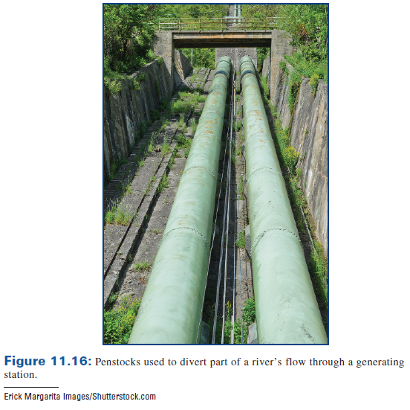
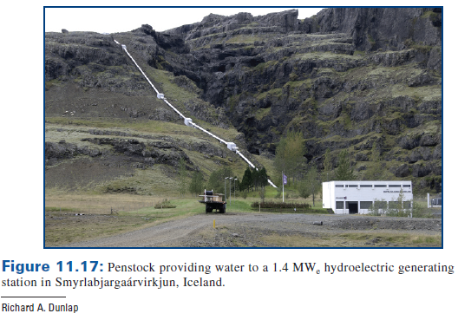
Penstock
Penstock is the path of water from the reservoir to the to carry water to the turbine and generator facility

Slide 11
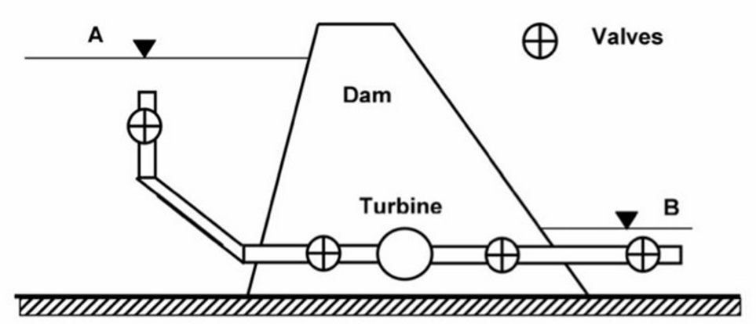
Flow Arrangement
The flow arrangement thus consists of an inlet, lengths of penstock, a turbine, and an exit
The arrangement typically has several valves, fittings, the turbine, and penstock lengths.
Large dams will have multiple penstocks and turbines.
Flow arrangement used for hydraulic analysis of dams

Slide 12
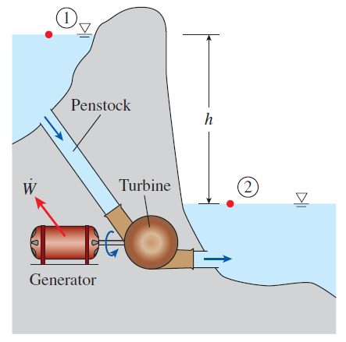

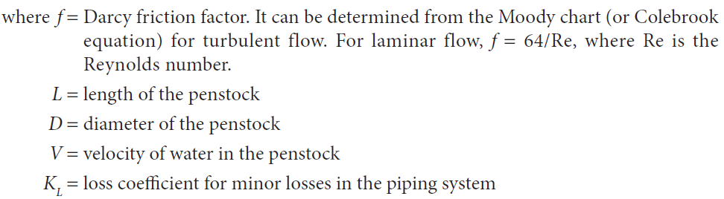
Hydraulic Analysis
The hydraulic analysis starts with the application of the conservation of energy equation, typically just called the energy equation, to the system.
Total head loss in the penstock:

Slide 13

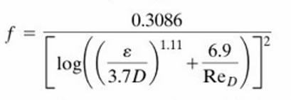
Penstock Losses
Darcy friction factor
Re_{D} < 2300
Re_{D} > 2300
ε/D is the relative roughness of the penstock wall
Re = ρDV/μ, where D is the pipe diameter, V is the average flow velocity in the pipe, ρ is the density of the flowing fluid and μ is the dynamic viscosity of the flowing fluid (water). Re = ρDV/μ =DV/υ where υ is the kinematic viscosity of water (υ =μ/ρ). For water use: υ =1.141 x 10⁻⁶ m²/s

Slide 14
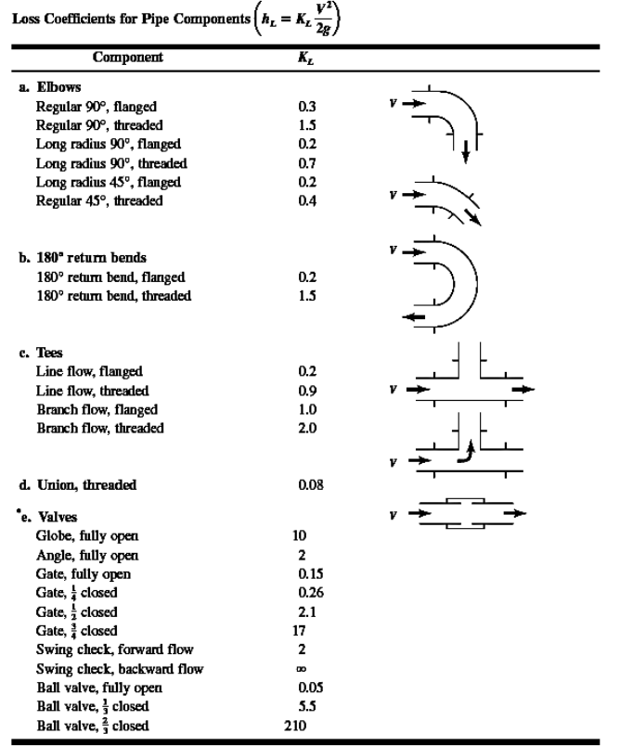
Minor Loses
Note that this table is for information only. A total K value will be provided for any analysis requested.

Slide 15


Power Developed by Turbine
${\dot{W}}_{turbine}=η_{turbine}\dot{m}$gh_{turbine,e}
Where effective head is found from energy balance (previous slides)

Slide 16


TURBINE SPECIFIC SPEED
Because of the wide range of elevation differences and flow rates associated with hydropower, a nondimensional analysis is carried, resulting in determination of turbine specific speed:
SI Version:
Where all variables in the in SI units
English units: this is usually shown as N’_{sp}
where

Slide 17
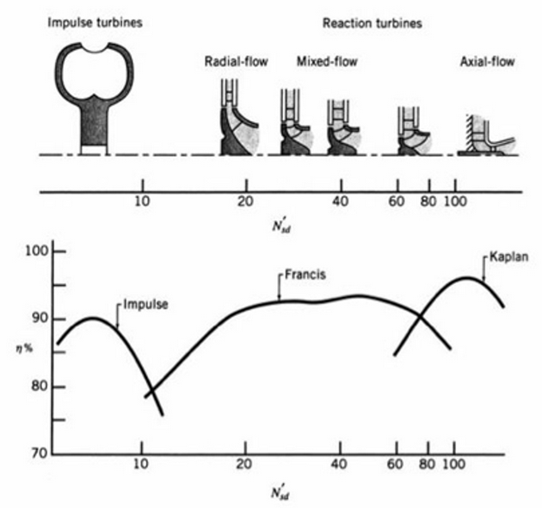
Turbine Selection
Operating conditions yield a specific speed, which in turn can be used to determine a suitable turbine or optimal operating conditions

